Slide 1






Foundations of
Quantum Information Science (QIS 102)
Dave Biersach
Brookhaven National Laboratory
dbiersach@bnl.gov
Session 13
Fourier Analysis

Slide 2
Session 13 – Goals
Perform Fourier Analysis using the Discrete Fourier Transform (DFT)
Perform Fourier Synthesis using the Inverse Discrete Fourier Transform (IDFT)
Investigate radio transmissions received from deep space
Determine the fundamental frequency of Sunspot Activity
Use the DFT to remove high frequency interference
Consider the DFT of a damped oscillator
Correlate the Heisenberg Uncertainty Principle to the Fourier Transform

Slide 3
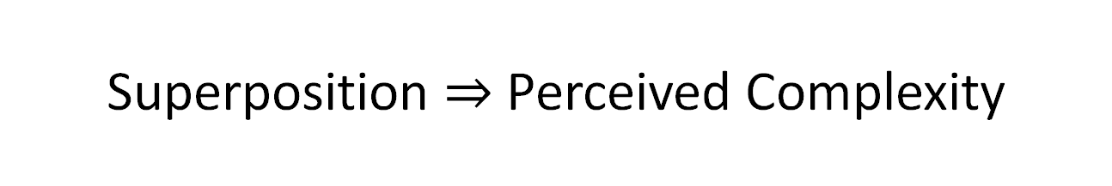
Superposition $⇒$ Perceived Complexity
What appears to be a complicated waveform might be just a series of simple waves all added together (in a linear superposition)
Underneath the perceived random behavior of a function undergoing wild fluctuations might be a system of straightforward waves
These simple waves may individually convey some important knowledge about the true nature of the observed complexity
The process of determining the underlying simple waveforms that make up a complicated wave is called Fourier Analysis

Slide 4
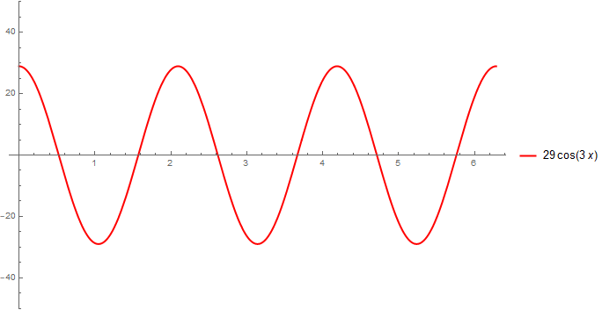
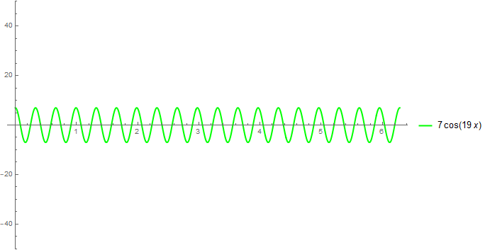
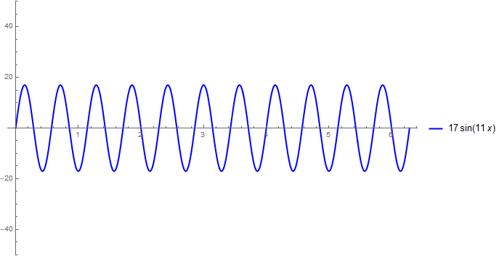
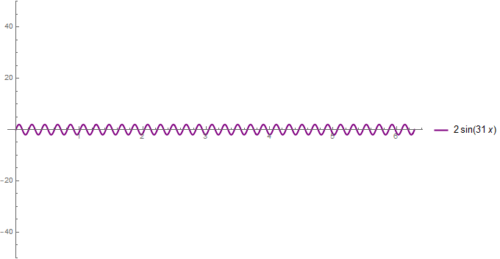
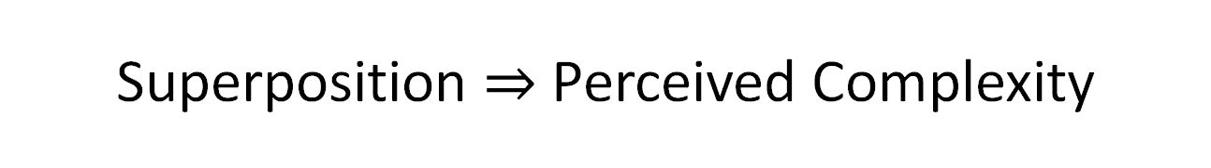
Superposition $⇒$ Perceived Complexity
Wave #1
Wave #3
Wave #2
Wave #4

Slide 5
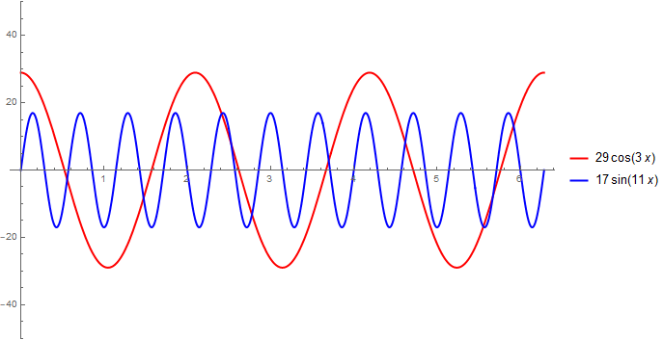
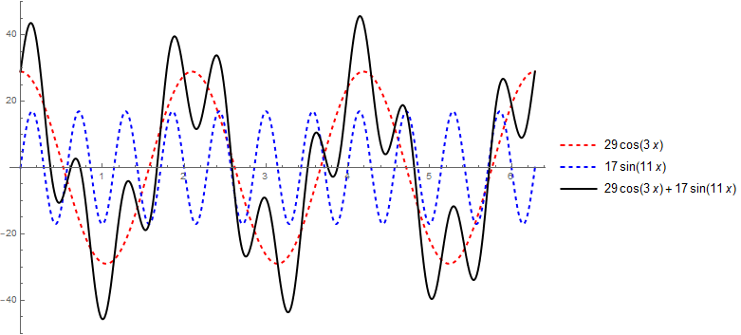
Superposition $⇒$ Perceived Complexity
Wave #1
Wave #1 & #2
Wave #1 + #2
Wave #2

Slide 6
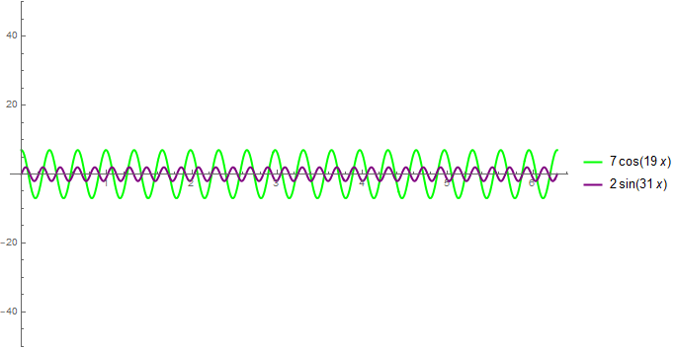
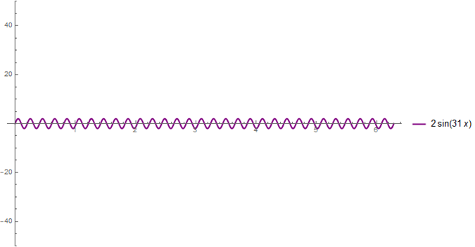
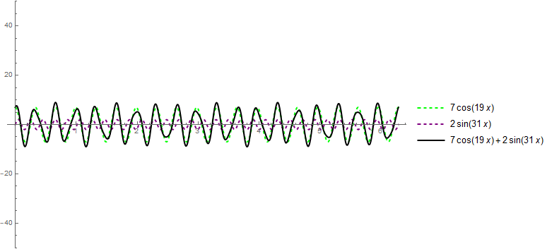
Superposition $⇒$ Perceived Complexity
Wave #3
Wave #3 & #4
Wave #3 + #4
Wave #4

Slide 7
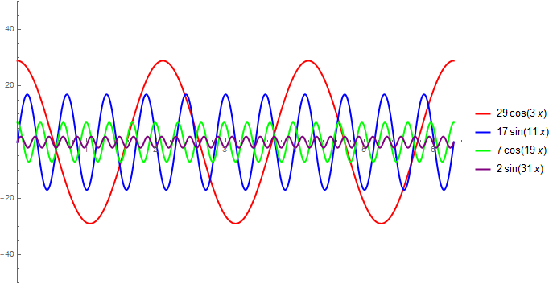
Superposition $⇒$ Perceived Complexity
Waves #1 & #2 & #3 & #4

Slide 8
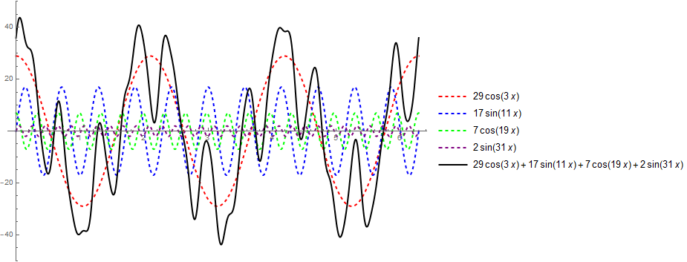
Superposition $⇒$ Perceived Complexity
Waves #1 + #2 + #3 + #4

Slide 9
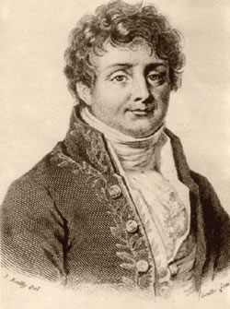
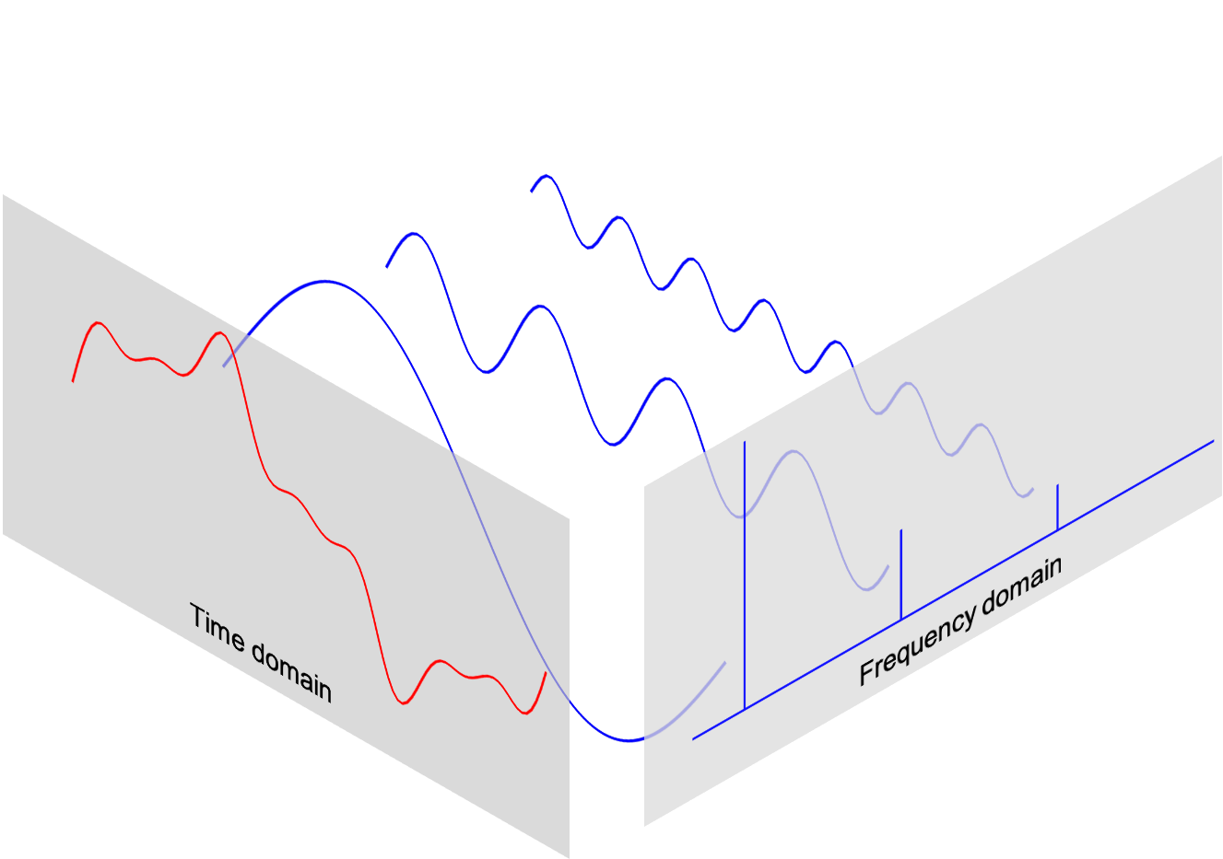
Fourier Transform
Continuous and Discrete
Jean-Baptiste Fourier (1768-1830)
both r’s are silent
“Foo-yay”

Slide 10
Fourier Analysis
Converting a complicated wave into a sum of simple waves having potentially non-integer amplitudes but integer frequencies is called the Fourier Transform
The reverse process of reconstructing the original complicated wave by summing all the contributions of the simple waves is called the Inverse Fourier Transform
It is a transform because we are converting back and forth between representing a wave as a sum of amplitudes over time versus a sum of amplitudes over integer frequencies
It is two sides of the same mirror – both approaches equally describe the same wave – but the frequency view often reveals hidden patterns in the wave

Slide 11
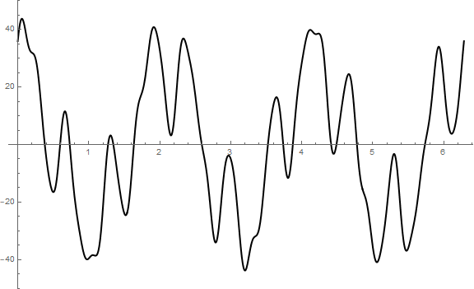
Fourier Analysis
$$y\left(x\right)=29\cos\left(3x\right)+17\sin\left(11x\right)+7\cos\left(19x\right)+2\sin\left(31x\right)$$
…how can we determine each "term" (each simple wave) in the superposition?
Given a complicated wave…

Slide 12
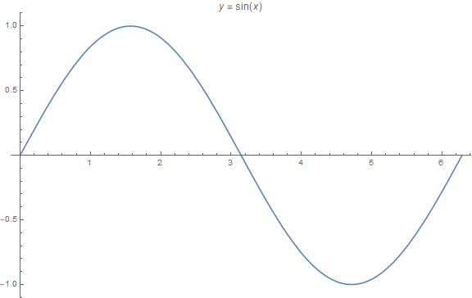
Fourier Analysis - Intuition
$$0 ≤x <2π$$
$$\int_{0}^{2π}{\sin\left(x\right)dx=0}$$

Slide 13
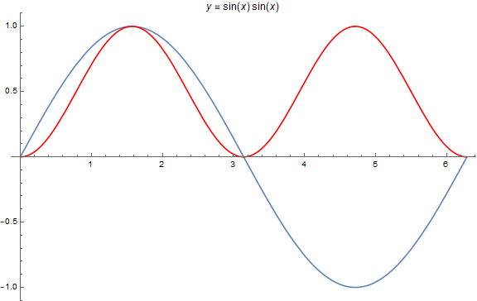
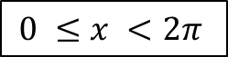
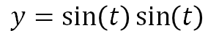
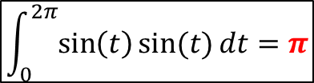
Fourier Analysis - Intuition
$$0 ≤x <2π$$
$$y=\sin\left(t\right)\sin\left(t\right)$$
$$\int_{0}^{2π}{\sin\left(t\right)\sin{(t)}dt=π}$$

Slide 14
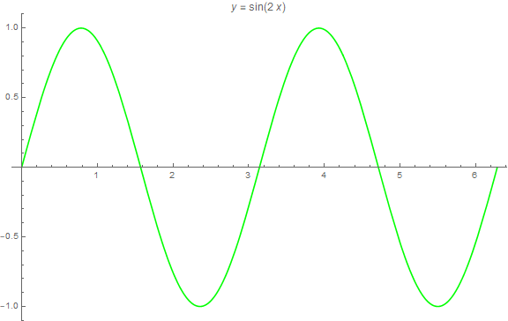
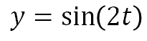
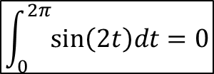
Fourier Analysis - Intuition
$$0 ≤x <2π$$
$$y=\sin\left(2t\right)$$
$$\int_{0}^{2π}{\sin\left(2t\right)dt=0}$$

Slide 15
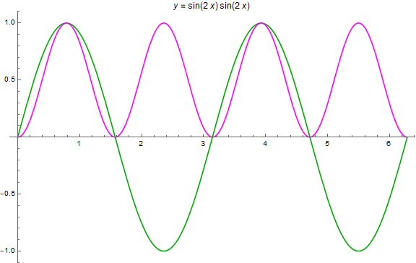
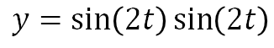
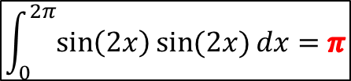
Fourier Analysis - Intuition
$$0 ≤x <2π$$
$$y=\sin\left(2t\right)\sin\left(2t\right)$$
$$\int_{0}^{2π}{\sin\left(2x\right)\sin{(2x)}dx=π}$$

Slide 16
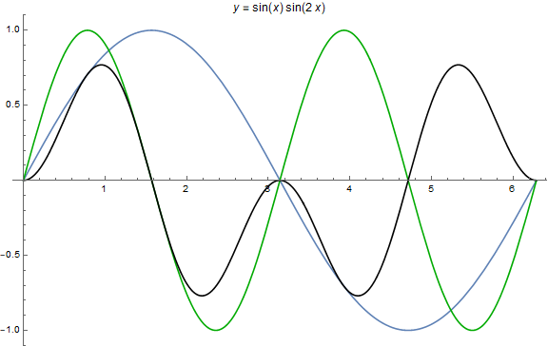
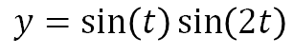
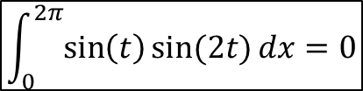
Fourier Analysis - Intuition
$$0 ≤x <2π$$
$$y=\sin\left(t\right)\sin\left(2t\right)$$
$$\int_{0}^{2π}{\sin\left(t\right)\sin{(2t)}dx=0}$$

Slide 17
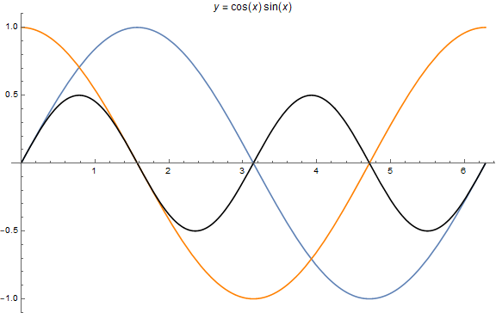
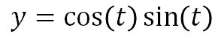
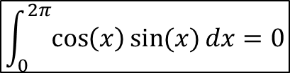
Fourier Analysis - Intuition
$$0 ≤x <2π$$
$$y=\cos\left(t\right)\sin\left(t\right)$$
$$\int_{0}^{2π}{\cos\left(x\right){\sin{(x)}dx}=0}$$

Slide 18
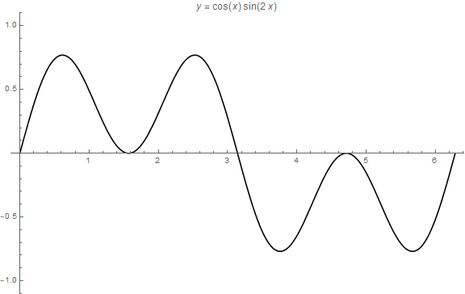
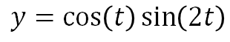
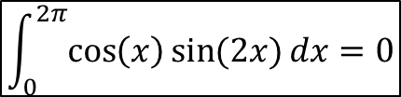
Fourier Analysis - Intuition
$$0 ≤x <2π$$
$$y=\cos\left(t\right)\sin\left(2t\right)$$
$$\int_{0}^{2π}{\cos\left(x\right){\sin{(2x)}dx}=0}$$

Slide 19
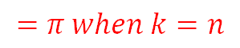
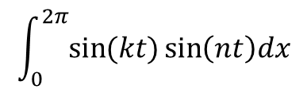
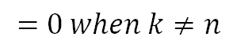
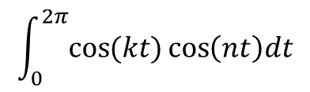
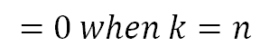
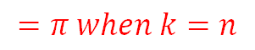
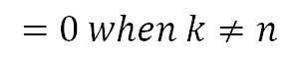
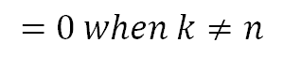
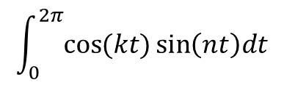
Fourier Analysis - Intuition
$$\int_{0}^{2π}{\sin{(kt)\sin\left(nt\right)dx}}$$
$$=π when k=n$$
$$=0 when k≠n$$
The only time the integral of the product of two sinusoids is > 0 is when both waves have matching frequency and phase
$$\int_{0}^{2π}{\cos{(kt)\cos\left(nt\right)dt}}$$
$$=π when k=n$$
$$=0 when k≠n$$
$$\int_{0}^{2π}{\cos{(kt)\sin\left(nt\right)dt}}$$
$$=0 when k=n$$
$$=0 when k≠n$$
Only the simple "filter" (k) waves (each having an increasing integer frequency)
when multiplied against the "complicated" (n) wave
which yield a non-zero integral can be components of the original wave

Slide 20
Fourier Analysis
$$y\left(t\right)=29\cos\left(3t\right)+17\sin\left(11t\right)+7\cos\left(19t\right)+2\sin\left(31t\right)$$

Slide 21
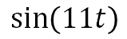
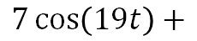
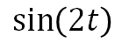
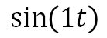
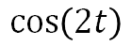



































































Fourier Analysis
$$\int_{0}^{2π}{f\left(t\right)y\left(t\right)dt}=\int_{0}^{2π}{f(t)\left[29\cos\left(3t\right)+17\sin\left(11t\right)+7\cos\left(19t\right)+2\sin\left(31t\right)\right]dt}$$
Filter Wave
Complicated Wave
$$\cos\left(1t\right)$$
$$29\cos\left(3t\right)+$$
$$\sin\left(1t\right)$$
$$29\cos\left(3t\right)+$$
$$\sin\left(11t\right)$$
$$29\cos\left(3t\right)+$$
$$\cos\left(1t\right)$$
$$17\sin\left(11t\right)+$$
$$\sin\left(1t\right)$$
$$17\sin\left(11t\right)+$$
$$\sin\left(11t\right)$$
$$17\sin\left(11t\right)+$$
$$\cos\left(1t\right)$$
$$7\cos\left(19t\right)+$$
$$\sin\left(1t\right)$$
$$7\cos\left(19t\right)+$$
$$\sin\left(11t\right)$$
$$7\cos\left(19t\right)+$$
$$\cos\left(1t\right)$$
$$2\sin\left(31t\right)+$$
$$\sin\left(1t\right)$$
$$2\sin\left(31t\right)+$$
$$\sin\left(11t\right)$$
$$2\sin\left(31t\right)+$$
$$\cos\left(2t\right)$$
$$29\cos\left(3t\right)+$$
$$\sin\left(2t\right)$$
$$29\cos\left(3t\right)+$$
$$\cos\left(19t\right)$$
$$29\cos\left(3t\right)+$$
$$\cos\left(2t\right)$$
$$17\sin\left(11t\right)+$$
$$\sin\left(2t\right)$$
$$17\sin\left(11t\right)+$$
$$\cos\left(19t\right)$$
$$17\sin\left(11t\right)+$$
$$\cos\left(2t\right)$$
$$7\cos\left(19t\right)+$$
$$\sin\left(2t\right)$$
$$7\cos\left(19t\right)+$$
$$\cos\left(19t\right)$$
$$7\cos\left(19t\right)+$$
$$\cos\left(2t\right)$$
$$2\sin\left(31t\right)+$$
$$\sin\left(2t\right)$$
$$2\sin\left(31t\right)+$$
$$\cos\left(19t\right)$$
$$2\sin\left(31t\right)+$$
$$\cos\left(3t\right)$$
$$29\cos\left(3t\right)+$$
$$\sin\left(3t\right)$$
$$29\cos\left(3t\right)+$$
$$\sin\left(31t\right)$$
$$29\cos\left(3t\right)+$$
$$\cos\left(3t\right)$$
$$17\sin\left(11t\right)+$$
$$\sin\left(3t\right)$$
$$17\sin\left(11t\right)+$$
$$\sin\left(31t\right)$$
$$17\sin\left(11t\right)+$$
$$\cos\left(3t\right)$$
$$7\cos\left(19t\right)+$$
$$\sin\left(3t\right)$$
$$7\cos\left(19t\right)+$$
$$\sin\left(31t\right)$$
$$7\cos\left(19t\right)+$$
$$\cos\left(3t\right)$$
$$2\sin\left(31t\right)+$$
$$\sin\left(3t\right)$$
$$2\sin\left(31t\right)+$$
$$\sin\left(31t\right)$$
$$2\sin\left(31t\right)+$$

Slide 22



Fourier Analysis
$$y\left(t\right)=29\cos\left(3t\right)+17\sin\left(11t\right)+7\cos\left(19t\right)+2\sin\left(31t\right)$$
But how do we determine the amplitudes of the simple waves?
$$\int_{0}^{2π}{y\left(t\right)ⅆt}=\int_{0}^{2π}{\left(A_{3}\cos\left(3t\right)+B_{11}\sin\left(11t\right)+A_{19}\cos\left(19t\right)+B_{31}\sin\left(31t\right)\right)}ⅆt$$
Integral of Sum = Sum of Integrals
(Amplitudes are constant and move outside the Integral)
Filter Wave
$$\int_{0}^{2π}{\cos\left(3t\right)y\left(t\right)ⅆt}=A_{3}\int_{0}^{2π}{\cos\left(3t\right)\cos\left(3t\right)}ⅆt+0+0+0$$
$$\int_{0}^{2π}{\cos\left(3t\right)y\left(t\right)ⅆt}=A_{3}\left(π\right)$$
See slide #19

Slide 23




Fourier Analysis
$$y\left(t\right)=29\cos\left(3t\right)+17\sin\left(11t\right)+7\cos\left(19t\right)+2\sin\left(31t\right)$$
But how do we determine the amplitudes of the simple waves?
$$\int_{0}^{2π}{y\left(t\right)ⅆt}=\int_{0}^{2π}{\left(A_{3}\cos\left(3t\right)+B_{11}\sin\left(11t\right)+A_{19}\cos\left(19t\right)+B_{31}\sin\left(31t\right)\right)}ⅆt$$
Integral of Sum = Sum of Integrals
(Amplitudes are constant and move outside the Integral)
Filter Wave
$$\int_{0}^{2π}{\sin\left(11t\right)y\left(t\right)ⅆt}=0+B_{11}\int_{0}^{2π}{\sin\left(11t\right)sin\left(11t\right)}ⅆt+0+0$$
$$\int_{0}^{2π}{\cos\left(3t\right)y\left(t\right)ⅆt}=A_{3}\left(π\right)$$
$$\int_{0}^{2π}{\sin\left(11t\right)y\left(t\right)ⅆt}=B_{11}\left(π\right)$$
See slide #19
$$\int_{0}^{2π}{\cos\left(19t\right)y\left(t\right)ⅆt}=A_{19}\left(π\right)$$
$$\int_{0}^{2π}{\sin\left(31t\right)y\left(t\right)ⅆt}=B_{31}\left(π\right)$$

Slide 24
Discrete Fourier Analysis
Converting a sampled complicated wave into a series of simple waves, each with amplitudes at specific integer frequencies, is called the Discrete Fourier Transform (DFT)
The reverse process of reconstructing the original complex wave by summing all the contributing simple waveforms is called the Inverse Discrete Fourier Transform (IDFT)
The sum of many discrete samples of a wave approximates its continuous integral if the spacing (time) between samples is sufficiently small – this is analogous to taking a Riemann sum as the width of each rectangular area strip approaches zero

Slide 25














Discrete Fourier Analysis
$$0$$
$$\left(\sum{f\left(t_{0}\right)+f\left(t_{1}\right)+⋯+f\left(t_{n}\right)}\right)$$
$$2π$$
$$\int_{a}^{b}{f\left(t\right)ⅆt}=\lim_{n→∞}{\sum_{s=0}^{n−1}{f\left(t_{s}\right)∙Δt}}$$
$$Δt$$
$$Δt=\frac{b−a}{n}$$
$$f\left(t_{s}\right)$$
$$a=0,b=2π→Δt=\frac{2π}{n}$$
$$\int{=\frac{2π}{n}\left(\sum{ }\right)}$$
$$\int{=A_{k}π}$$
$$A_{k}π=\frac{2π}{n}\left(\sum{ }\right)$$
Same formula for $B_{k}$
$$A_{k}=\frac{2}{n}\sum{f\left(t_{s}\right)}$$

Slide 26










Discrete Fourier Analysis
The integral of any cosine wave from $0$ to $2π$ equals zero
Filter
Wave
Complicated Wave
0
$$\int_{0}^{2π}{\cos\left(0t\right)\left[A\cos\left(nt\right)+y_{0}\right]ⅆt}$$
$$=\left[\int_{0}^{2π}{A\cos\left(nt\right)ⅆt}\right]+\left[y_{0}\int_{0}^{2π}{ⅆt}\right]=2πy_{0}$$
Filter Wave
Number
Offset
Filter Wave
Number
$$k>0→\int{=A_{k}π}$$
$$k=0→\int{=2πy_{0}}$$
$$A_{k}=\frac{2}{n}\sum{f\left(t_{s}\right)}$$
$$2πy_{0}=\frac{2π}{n}\left(\sum{ }\right)$$
See prior slide
The first DFT term $A_{0}$ should not be multiplied by 2 while all later terms $A_{n}$ must be multiplied by 2
$$y_{0}=\frac{1}{n}\sum{f\left(t_{s}\right)}$$
$y_{0}$ = Offset = DC Value

Slide 27










Discrete Fourier Transform (DFT)
$$𝓎\left(t_{s}\right)≈\sum_{n=0}^{N−1}{\left[A_{n}\cos\left(nt_{s}\right)+B_{n}\sin\left(nt_{s}\right)\right]}$$
$N$ is the number of samples
$e^{i(k⋅t_{s}\left[n\right])}$ is the $k^{th}$ filter wave
Euler’s Formula
DFT (complex)
$$Y\left[k\right]=\frac{2}{N}\sum_{n=0}^{N−1}{y\left[n\right]e^{i\left(k{⋅t}_{s}\left[n\right]\right)}}$$
$$e^{iθ}=\cos{θ}+i\sin{θ}$$
$y\left[n\right]$ are the real-valued sampled wave amplitudes
$$\cos{θ}=\frac{e^{iθ}+e^{−iθ}}{2}$$
Inverse DFT (complex)
$Y\left[n\right]$ are the complex amplitudes for each filter wave number $k$
$$\sin{θ}=\frac{e^{iθ}−e^{−iθ}}{2i}$$
$$y\left[n\right]=\sum_{n=0}^{N−1}{Y\left[k\right]e^{−i\left(k⋅t_{s}\left[n\right]\right)}}$$

Slide 28

Open make_samples.py
We are generally not privy to the underlying formula that generated the measured (complicated) wave
①

Slide 29

View make_samples.py
①
②
Avoid duplicate endpoints
③
④
⑤
⑥
2 rows x 1000 columns
1000 rows x 2 columns
⑦

Slide 30



Run make_samples.py
There is no obvious pattern within the complicated waveform
$$0$$
$$2π$$

Slide 31



Open samples.csv
$$t_{s}=sample time$$
$$y_{s}=sample value$$
The program generated this “comma separated value” (CSV) text file that contains the sampled sinusoid data points

Slide 32
Discrete Fourier Analysis
We now wish to analyze the sample data through the lens of Fourier Analysis
We know that Mother Nature often shows us only her complicated side, and our job as scientists is to unravel those mysteries – to get to the simplicity and beauty hiding behind that complexity
Often the true nature of the underlying physical laws generating the measured data can be better understood by identifying the simple waves that (when in superposition) appear to be a complicated signal
Fourier Analysis is the microscope of scientific computing – it is one of the most powerful methods we have in our toolbox

Slide 33

Open fourier_discrete.py
②
③
④
⑤
⑥
⑦
⑧
⑨
⑩
①

Slide 34


View fourier_discrete.py
①
②
③
④
⑤
⑥
⑦
⑧

Slide 35

View fourier_discrete.py
①
②
③
④
⑤
⑥

Slide 36

View fourier_discrete.py
①
②
③
④

Slide 37

Run fourier_discrete.py

Slide 38

Unravelling the Complicated Wave
$$y\left(t\right)=29\cos\left(3t\right)+17\sin\left(11t\right)+7\cos\left(19t\right)+2\sin\left(31t\right)$$

Slide 39

Reconstructing the Complicated Wave
The Inverse DFT was able to identically reconstruct the original complicated wave by summing together only four simple waves

Slide 40

Information Density
$$y\left(t\right)=29\cos\left(3t\right)+17\sin\left(11t\right)+7\cos\left(19t\right)+2\sin\left(31t\right)$$
Time domain
Frequency domain
1000 time values
1000 amplitude values
4 frequency values
4 amplitude values
All the complexity of the original waveform
in the time domain (2000 numbers) is fully described using just eight numbers in the frequency domain!

Slide 41

Every JPEG Image uses the DFT

Slide 42

All Streaming Video Services use the DFT
VP10 – March 2018
June 2013
May 2003

Slide 43

The Most Important Algorithm Ever Invented
The FFT can easily perform a DFT one billion times faster than our naïve approach!
https://www.youtube.com/watch?v=h7apO7q16V0

Slide 44



The Most Important Algorithm Ever Invented
1965
①

Slide 45


Analysis of Space Signals
Mojave Desert in California
The NASA 70m Antenna has detected three candidate signals originating from deep space
Your task is to perform Fourier Analysis on each signal to determine which one is more likely to have been a broadcast from an extraterrestrial intelligence

Slide 46

Space Signal # 1

Slide 47

Space Signal # 2

Slide 48

Space Signal # 3

Slide 49


Open fft.py
①
②
③

Slide 50

View fft.py
①

Slide 51

Run fft.py – space_signal1.csv

Slide 52
Run fft.py – space_signal2.csv

Slide 53

Edit fft.py
①

Slide 54

Run fft.py – space_signal2.csv

Slide 55

Edit fft.py
①

Slide 56

Run fft.py – space_signal3.csv

Slide 57

Analysis of Space Signals
Mojave Desert in California
The NASA 70m Antenna has detected three candidate signals originating from deep space
Your task is to perform Fourier Analysis on each signal to determine which one is more likely to have been a broadcast from an extraterrestrial intelligence

Slide 58

space_signal1.csv
The cosine and sine waves alternate, demonstrating on/off (Boolean) logic
The amplitudes are the squares of the first four prime numbers $\left(2^{2}, 3^{2},5^{2},7^{2}\right)$
The frequencies $\left(1,6,7,8\right)$ match the number of protons in Hydrogen(1), Carbon(6), Nitrogen(7), and Oxygen(8) : the most prevalent atoms in organic chemistry
It is very unlikely this signal could have been constructed by some random process

Slide 59
Who can see this signal carries so much embedded intelligence?
Space Signal # 1

Slide 60

Sunspot Activity

Slide 61

Sunspot Activity

Slide 62


Sunspot Activity
sunspots.csv
Humans have counted sunspots every day from 1700 – 2016!

Slide 63
Power Spectrum
The green “Power Spectrum” graph shows the magnitude (modulus) of the complex terms representing the amplitudes of every frequency present in the original signal
High peaks in a power spectrum indicate the significant (dominant) frequencies in the original complicated waveform
Can we use the power spectrum graph to determine the main underlying period of the recurring sunspot cycles?

Slide 64

Edit fft.py
①

Slide 65


Run fft.py – sunspots.csv
Which is the dominant frequency (29 or 30)?
There is an unexplained ~11-year cycle in sunspot activity!

Slide 66

Creating a High Frequency Filter
High frequency interference is distorting the capture of what we believe to be a stable (clean) primary signal
We want to remove this high frequency jitter (interference) before using the inverse discrete Fourier transform (IDFT) so we can reconstruct the original undistorted signal

Slide 67

Creating a High Frequency Filter
The DFT identifies the constituent simple waves which compose a complicated wave
This interference could be filtered by eliminating the simple waves that have a high frequency
This is the primary signal
This is the interference

Slide 68

Run fourier_filter.py
We can zero out the amplitude of the high frequency component of the sampled wave
We want to remove this high-frequency noise (wiggle)

Slide 69

Edit fourier_filter.py
①
②
③
④

Slide 70

Run fourier_filter.py
The original pure signal has been faithfully isolated

Slide 71

The Limits of Fourier Analysis
In the first lab, the amplitudes of each of the constituent simple waves were constant throughout the sample period
Consider a sinusoid where the amplitudes are changing over the sample period, such as with a damped oscillator
$$y\left(t\right)=13e^{−t}\left[17\cos\left(3t\right)+7\sin\left(23t\right)\right]$$
What do you think the DFT will reveal?
Can we determine the decay factor from the DFT?
$$y\left(t\right)=29\cos\left(3t\right)+17\sin\left(11t\right)+7\cos\left(19t\right)+2\sin\left(31t\right)$$

Slide 72

The DFT of Damped Oscillators
This is a complicated sinusoid where the amplitude is also decaying exponentially

Slide 73

Edit fft.py
①

Slide 74


Run fft.py – samples_decay.csv
$$y\left(t\right)=13e^{−t}\left[17\cos\left(3t\right)+7\sin\left(23t\right)\right]$$

Slide 75
The Limits of Fourier Analysis
$$y\left(t\right)=13e^{−t}\left[17\cos\left(3t\right)+7\sin\left(23t\right)\right]$$
How can we determine these values?

Slide 76



The Laplace Transform is the Generalized Fourier Transform
The Z-transform (the discrete version of the Laplace Transform) can identify the exponential decay factor for damped oscillators
Pierre-Simon Laplace
1749 - 1820

Slide 77




Heisenberg Uncertainty Principle

Slide 78

Open uncertainty_principle.py
The left-hand plot shows the probability density function (PDF) for finding a particle at position $x$ at any given moment
The right-hand plot is the Fourier Transform Power Spectrum graph for the PDF at that instant in time
As time progresses, the PDF narrows, meaning it is more likely the particle will be found precisely at location $x=0$
At halfway through the simulation, we begin to widen the location PDF, and conversely, the Fourier Transform Power Spectrum starts to narrow, indicating the momentum is composed of fewer frequencies, so we have a better idea of the particle’s momentum (e.g., velocity)

Slide 79




Run uncertainty_principle.py
…the less we know about the location
The more we know about the momentum…
$p$ is momentum $\left(m×v\right)$
$$p=\frac{E}{c}=\frac{ℏω}{c}=\frac{ℏ\left(2πf\right)}{c}=\frac{ℏ\left(2π\frac{c}{λ}\right)}{c}=\frac{ℏ2π}{λ}=ℏk$$
$k$ is wavenumber (related to frequency)
Louis de Broglie "wave particle duality"

Slide 80

Run uncertainty_principle.py

Slide 81

Run uncertainty_principle.py
…the more we can know about the location
The less we know about the momentum…

Slide 82

Run uncertainty_principle.py

Slide 83

Run uncertainty_principle.py

Slide 84


Run uncertainty_principle.py
… then we can know the precise location
If we don't know the momentum at all…
The more unique values a particle's momentum $\left(p=m×v\right)$ can assume, the less we can know about where the particle is going, since we'll have greater uncertainty about its velocity (if mass is fixed)

Slide 85
Session 13 – Now You Know…
Fourier Analysis is the microscope of scientific computing
What appears to be a complicated waveform in the time domain might have a simple underlying representation in the frequency domain
The Fourier Transform determines the amplitudes and wavelengths of the constituent simple sinusoids that make up a complicated waveform
Discrete Fourier Transform (DFT) can provide insight in the character of the physical law generating the observables
The Fourier Transform is just a special case of the more general Laplace Transform that can analyze signals having both sinusoids and exponential growth/decay

Slide 86
Session 13 – Now You Know…
The famous Heisenberg Uncertainty Principle is not some spooky effect rooted in the magical world of quantum mechanics. It is merely a mathematical result of momentum and position being Fourier conjugate variables
It is not a matter of engineering more precise instrumentation; the uncertainty principle fundamentally limits our ability to perfectly know both momentum and position of a particle at the same time
Per Maxwell, Planck, Einstein, and de Broglie we know all matter particles (big and small) behave as waves – so you must really understand waves to appreciate science!

Slide 87

Task 13-01
The data file samples_square.csv contains captured waveform data of a signal having amplitude = 1 over the interval $π−\frac{π}{2}≤t≤π+\frac{π}{2}$and a zero amplitude elsewhere
In the program square_wave.py, below the call to main(), in a comment block (using triple-quoted strings), answer these three questions in your own words:
Why does the power spectrum of the sampled waveform have so many frequencies?
Why does the magnitude of the DC component $=1/2$ ?
Why are there no sine components in its DFT?
Upload your modified square_wave.py file to your folder in the BNL QIS102 SharePoint site

Slide 88

Task 13-02
In the program uncertainty_principle.py, below the call to main(), in a comment block (using triple-quoted strings), answer these three questions in your own words:
Why do the Fourier Transform frequencies spread out as we more tightly confine where the particle is likely to be found?
At the end of the animation, when the Power Spectrum shows only one frequency, why does the probability of finding the particle at any point $x$ spread out infinitely?
Do you believe a particle with 100% exactly known momentum could potentially exist anywhere in the universe – why or why not?
Upload your modified uncertainty_principle.py file to your folder in the BNL QIS102 SharePoint site

Slide 89

Task 13-03
The data file unknown_wave.csv contains captured waveform data generated by this formula:
$$y\left(t\right)=2\sin\left(αt\right)\cos\left(βt\right),0≤t<2π$$
Determine the two values: $α$ and $β$
Edit the program plot_unknown_wave.py to draw that waveform using the correct values of $α$ and $β$
Upload your modified plot_unknown_wave.py file to your folder in the BNL QIS102 SharePoint site

